Slide 1

BOSH introduction

Slide 2
BOSH Terminology

Slide 3
Deployment
BOSH release +
Stemcells +
Deployment manifest
Notes:
goal:
single platform for all devices
Increase quality and reduce the amount of stabilization
reduce planning.
PaaS is good fit for Project automatization
tests should be small.

Slide 4
Release
Software we want to run in the cloud
Dependencies (compile and runtime)
Software configuration information
Notes:
goal:
single platform for all devices
Increase quality and reduce the amount of stabilization
reduce planning.
PaaS is good fit for Project automatization
tests should be small.

Slide 5
Stemcell
Versioned Operating System image wrapped with IaaS specific packaging
Contains Bosh Agent
Have different format for different IaaS providers (VMDK for vSphere,ami id for AWS)
Notes:
goal:
single platform for all devices
Increase quality and reduce the amount of stabilization
reduce planning.
PaaS is good fit for Project automatization
tests should be small.

Slide 6
Deployment manifest
A YAML file that defines components and properties of a deployment:
Deployment Identification
Releases configuration
Networks configuration
Types of VMs to be managed by BOSH
Disks configuration
Compilation VMs configuration
Jobs configuration and resource information
Properties: Global properties and generalized configuration information
Notes:
goal:
single platform for all devices
Increase quality and reduce the amount of stabilization
reduce planning.
PaaS is good fit for Project automatization
tests should be small.

Slide 7
Jobs, errands, compilation VMs
Job: usually referred to a LRP; contains startup, shutdown scripts, and configuration files that tell the Agent how to start, run and monitor software on a VM. Jobs can depend on packages for necessary software. One VM can have many jobs.
Errand: a short-lived job that an operator can run multiple times after the deploy finishes.
Compilation VM: a dedicated VM to compile the packages specified in a release. It is short lived and is created and destroyed when a package isn’t found in the Blobstore.
Notes:
goal:
single platform for all devices
Increase quality and reduce the amount of stabilization
reduce planning.
PaaS is good fit for Project automatization
tests should be small.

Slide 8
BOSH Architecture

Slide 9
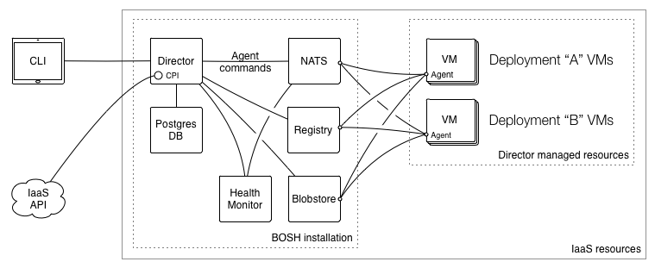
BOSH architecture
Notes:
goal:
single platform for all devices
Increase quality and reduce the amount of stabilization
reduce planning.
PaaS is good fit for Project automatization
tests should be small.

Slide 10
Components: Blobstore
Internal storage solution for BOSH
Sources, releases (jobs, packages, tgz with release)
Saves the performed uploads from the director
Works as an intermediary between the director and the agent for all jobs, packages, and sources
Storing other large BOSH payloads, such as log files and output from the BOSH Agent that exceeds the max size for messages over the message bus
Notes:
goal:
single platform for all devices
Increase quality and reduce the amount of stabilization
reduce planning.
PaaS is good fit for Project automatization
tests should be small.

Slide 11
Components: Director
Provides core orchestrating component in bosh
Controls VM creation and deployments
Manages lifecycle events on the deployment
Notes:
goal:
single platform for all devices
Increase quality and reduce the amount of stabilization
reduce planning.
PaaS is good fit for Project automatization
tests should be small.

Slide 12
Components: Director
It creates actionable tasks to:
Translate commands sent by the operator(Bosh CLI)
Scheduled processes such as backups and snapshots
Reconcile expected state vs the actual state of a VM if needed
Notes:
goal:
single platform for all devices
Increase quality and reduce the amount of stabilization
reduce planning.
PaaS is good fit for Project automatization
tests should be small.

Slide 13
Components: Task Queue
Asynchronous queue used by the Director and Workers to manage tasks. This Task Queue resides on the database.
Notes:
goal:
single platform for all devices
Increase quality and reduce the amount of stabilization
reduce planning.
PaaS is good fit for Project automatization
tests should be small.

Slide 14
Components: Director workers
Take tasks from the Task Queue and acts on them.
Notes:
goal:
single platform for all devices
Increase quality and reduce the amount of stabilization
reduce planning.
PaaS is good fit for Project automatization
tests should be small.

Slide 15
Components: Message Bus (NATS)
Messaging service system. Helps to:
Provision instructions to VMs
Monitor Health of VMs
Notes:
goal:
single platform for all devices
Increase quality and reduce the amount of stabilization
reduce planning.
PaaS is good fit for Project automatization
tests should be small.

Slide 16
Components: DNS Server
BOSH uses PowerDNS
Provides DNS name resolution across the deployment VMs
Notes:
goal:
single platform for all devices
Increase quality and reduce the amount of stabilization
reduce planning.
PaaS is good fit for Project automatization
tests should be small.

Slide 17
Components: Health Monitor
Uses status and lifecycle events received from Agents to monitor the health of VMs
It can send an alert through notification plugins, or trigger the Resurrector when if finds problems
Notes:
goal:
single platform for all devices
Increase quality and reduce the amount of stabilization
reduce planning.
PaaS is good fit for Project automatization
tests should be small.

Slide 18
Components: Resurrector
If enabled, the Resurrector plugin automatically recreates VMs identified by the Health Monitor as missing or unresponsive
Notes:
goal:
single platform for all devices
Increase quality and reduce the amount of stabilization
reduce planning.
PaaS is good fit for Project automatization
tests should be small.

Slide 19
Components: Registry
Stores VM configuration Information
Its involved during creation and update processes of VMs
Helps with bootstrapping process of the VMs
Notes:
goal:
single platform for all devices
Increase quality and reduce the amount of stabilization
reduce planning.
PaaS is good fit for Project automatization
tests should be small.

Slide 20
Components: Agent
Is installed on each VM created by BOSH
Executes Director commands
Update Director on current status
Notes:
goal:
single platform for all devices
Increase quality and reduce the amount of stabilization
reduce planning.
PaaS is good fit for Project automatization
tests should be small.

Slide 21
Components: CPI
API that the Director uses to interact with an IaaS
Create and manage stemcells, VMs, and disks
Abstracts the cloud infrastructure from the rest of BOSH
Notes:
goal:
single platform for all devices
Increase quality and reduce the amount of stabilization
reduce planning.
PaaS is good fit for Project automatization
tests should be small.

Slide 22
BOSH Deployment Sequence

Slide 23
Director
$ bosh deploy
Compilation
Deployment

Slide 24
Compilation stage
Create Compilation VM
Copy source files to VM
Run packaging script
Store compiled package in BOSH’s Blobstore

Slide 25
Deployment stage
Create Job VM
Copy compiled package to /var/vcap/packages/<pacage-name>
Generate job files based on templates
Copy job package to /var/vcap/jobs/<job-name>
Copy monit file to /var/vcap/monit
Start monit: monit start all

Slide 26
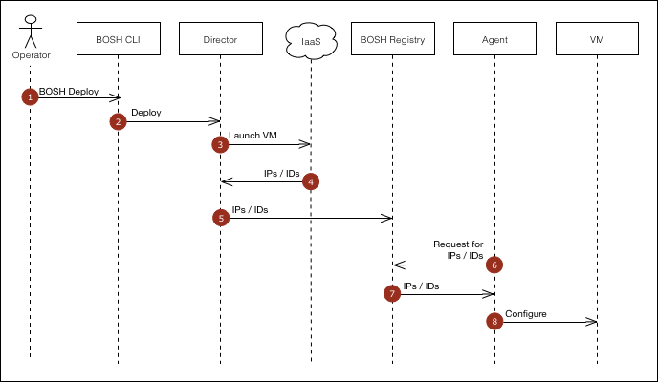
Bosh: VM creation sequence
Notes:
goal:
single platform for all devices
Increase quality and reduce the amount of stabilization
reduce planning.
PaaS is good fit for Project automatization
tests should be small.

